Slide 1
CP5804
Week 1 Session

Slide 2
Key dates (all times AEST)
Assessment task 1 – Conceptual database modelling (30%)
Due end of week 5 – 12 April 2020 11:59PM
Assessment task 2 – Normalisation (15%)
Due end of week 4 – 5 April 2020 11:59PM
Assessment task 3 – Implementation (15%)
Due Wednesday week 7 – 22 April 2020 11:59PM
Assessment 4 – Lab activities (25%)
Due end of week 2 to 6 – Sundays 11:59PM
Assessment 5 – SAS activities (15%)
Due weeks 4 to 7 – Wednesdays 11:59PM

Slide 3
Key dates
Assessment 4 – Lab activities (25%)
Due end of week 2 to 6 - Sundays 11:59PM
Assessment 5 – SAS activities (15%)
Due weeks 4 to 7 – Wednesdays 11:59PM

Slide 4
Using LearnJCU
Subject materials
Discussion boards
Submitting assessment

Slide 5
Weekly topics
Week 1: Introduction to Database Systems and Data Models
Week 2: Entity Relation Modelling
Week 3: Normalisation of Database Tables
Week 4: Introduction to SQL
Week 5: Advanced SQL
Week 6: Evaluation of Database Design
ASSESSMENT 1 – due week 5
ASSESSMENT 2 – due week 4
ASSESSMENT 3 – due week 7

Slide 6
Software to install
MySQL server and MySQL workbench
SAS (Sisi will discuss tomorrow night)

Slide 7
Week 1 topics
Data, information, databases and database design
Database (DB) and database management systems (DBMS)
Why is database design important?
Data processing before DB & DBMS (evolution of file system)
The database system environment
Data modelling and data models
Gather information – business rules
The relational database model (RDBM) – quick intro

Slide 8
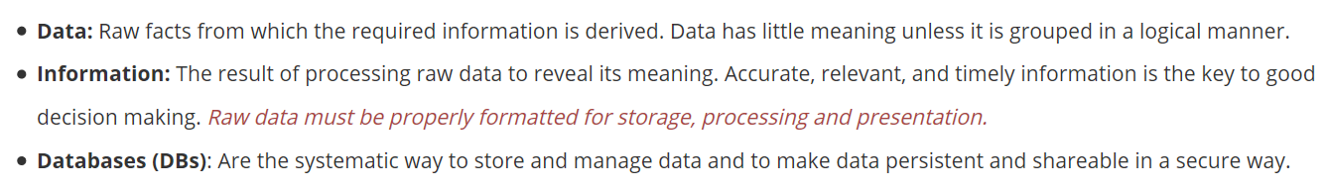
1. Data, information, databases and database design

Slide 9
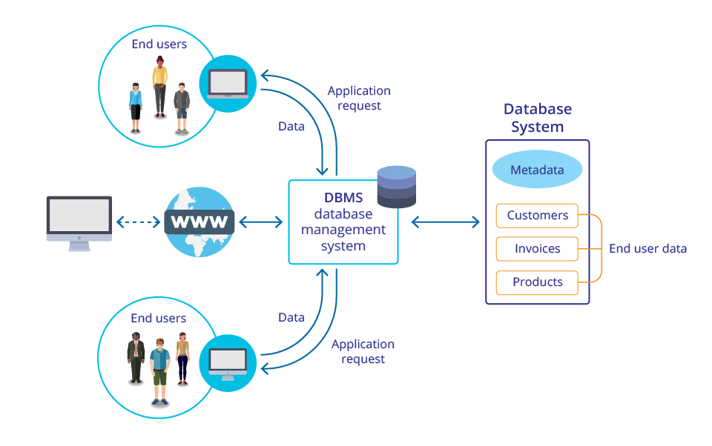
2. Database (DB) and database management systems (DBMS)

Slide 10
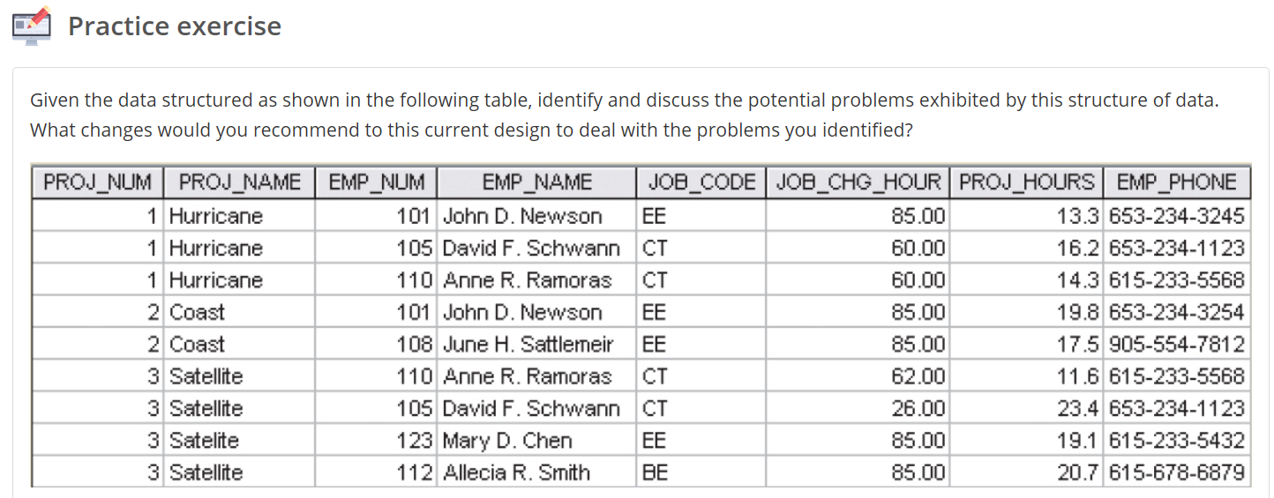
3. Why is database design important?

Slide 11
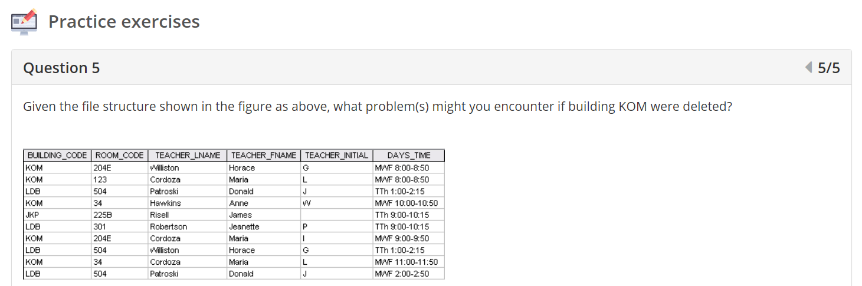
4. Data processing before DB & DBMS (evolution of file system)

Slide 12
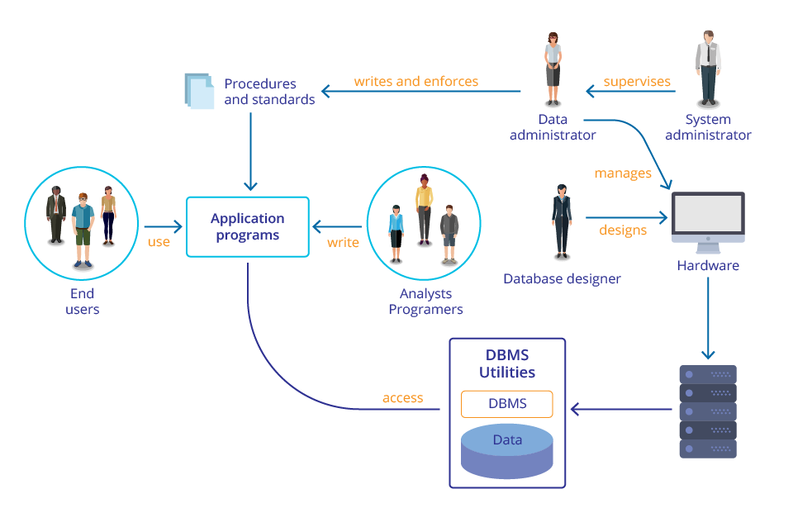
5. The database system environment

Slide 13
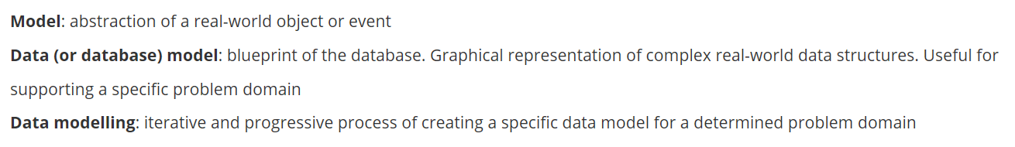
6. Data modelling and data models

Slide 14
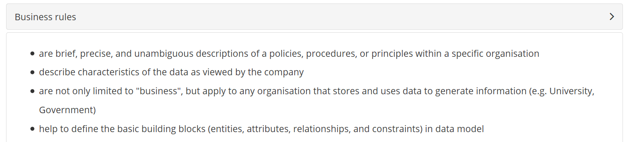
7. Gather information – business rules

